Slide 1
The role of data in the future of healthcare
Adam Steventon
NHS R Community
9 November 2020

Slide 2
Ensuring everyone’s health and care benefits from analytics and data-driven technology
Challenges for health and health care
Developments in analytics and data driven technology

Slide 3
UK health data timeline
1830s General Registry Office begins collecting national data on births, deaths and marriages
1948: Formation of NHS
1960s: Early experiments in data linkage
1980s: Digitisation of primary care
1980s: Körner reforms led to data collection for management purposes
1990s: data for clinical audit and improvement
2000s: data to inform patient choice of healthcare provider
2000s: efforts at national IT integration (failed)
2017: UK industrial strategy
2013: public concerns around privacy escalate with Care.data initiative

Slide 4
Data from the perspective of a typical…
NHS Commissioner or local authority
Technology company seeking to develop product
General practice
Hospital
Research team
National policy maker
Patient
Mental health treatment
Data linkage in some CCGs and local authorities
MHMDS
Letters
Deaths
CPRD
HES
Registry
Letters are loaded
manually
Inpatient
admissions
A&E attendances
Fragmented electronic health records held locally
Outpatient
appointments
Multiple fragmented systems exist within single hospital
A confusing set of returns, heavier for some sectors than others, each showing partial picture
Primary Care (GP data)
Electronic health record
Community
health
Multiple research databases, each showing partial picture
May be able to access medical records through portal
Little information beyond the hospital walls
Public facing quality measures
Social Care providers
Social Care payers

Slide 5
Analytical Capability: Three key elements
DATA
Timely access to data to inform decisions and strategy
Data quality
Good coding practices
Understanding of data limitations and appropriate use
Information governance
The skills and abilities to safely and responsibly use data to improve services and outcomes
PEOPLE
Analysts that are able to:
Understand and structure a problem
Apply appropriate analyses
Communicate their findings well
Leaders and managers that are data literate
Cross-organisational discussions involving the analytics team
“We base decisions on instincts and gut feelings rather than evidence”
TOOLS & INFRASTRUCTURE
Data collection tools that meet the needs of the individual collecting the data and the individual analysing the data
Appropriate software to perform analyses, freeing analyst time from mundane tasks
Appropriate data warehousing processes
Organisational infrastructure and processes that allow for timely analyses and presentation
“Lots of data and not enough insight”
“We don’t make the best use of our data”
“We have an overabundance of irrelevant information”
“There are cultural issues about evidence based decision making – we need to make it more impactful in all organisations”
“There is no entry criteria for analysts. No career path. They may have to leave the organisation to move up the ladder”

Slide 6
Data and COVID-19: some learning points
Much greater public engagement with data (e.g. tutorials on the R number)
Data has informed national decision making (e.g. daily Government briefings)
Remarkable innovation (e.g. RECOVERY trial)
Less innovation in some areas, linked to lower prior investment (e.g. social care)
Some groups suffer because their experiences are not made visible in the dataPublic and patient engagement and involvement has been missing in the development of new technologies
Data and methods have not been shared, leading to confusion, wasted resources, and poor decisions

Slide 7
What are we doing at the Health Foundation?

Slide 8
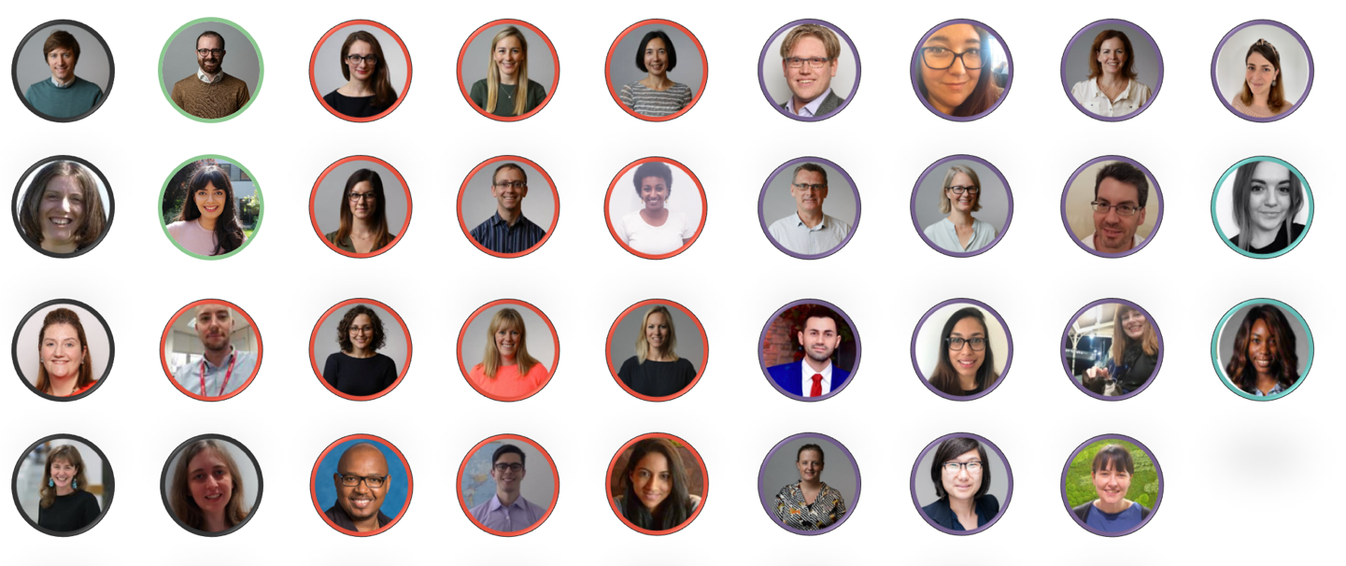
Who are we?

Slide 9
Vision: Everybody’s health & care benefits from analytics and data-driven technology
Objectives:
To create innovations in data analytics
To inform the national conversation about data and health
To support better data analytics across health & social care
To build data analytics partnerships
To support better data analytics across Health Foundation
Success means:
Influencing practice and policy
Demonstrating utility of novel analytics approaches
Create tools that are widely used
Influencing data and technology policy
Supporting analytical community
Demonstrating how data can be used to improve care
Tackling significant national issues in the use of health data through higher risk projects
Analytics teams across HF have data, technology, tools and skills they need

Slide 10
Vision: Everybody’s health & care benefits from analytics and data-driven technology
Objectives:
To create innovations in data analytics
To inform the national conversation about data and health
To support better data analytics across health & social care
To build data analytics partnerships
To support better data analytics across Health Foundation
Networked Data Lab
Advancing Applied Analytics
Improvement Analytics Unit
Strengthening Social Care Analytics
Success means:
Influencing practice and policy
Demonstrating utility of novel analytics approaches
Create tools that are widely used
Influencing data and technology policy
Supporting analytical community
Demonstrating how data can be used to improve care
Tackling significant national issues in the use of health data through higher risk projects
Analytics teams across HF have data, technology, tools and skills they need

Slide 11
Analysis of linked data sets
https://github.com/HFAnalyticsLab

Slide 12
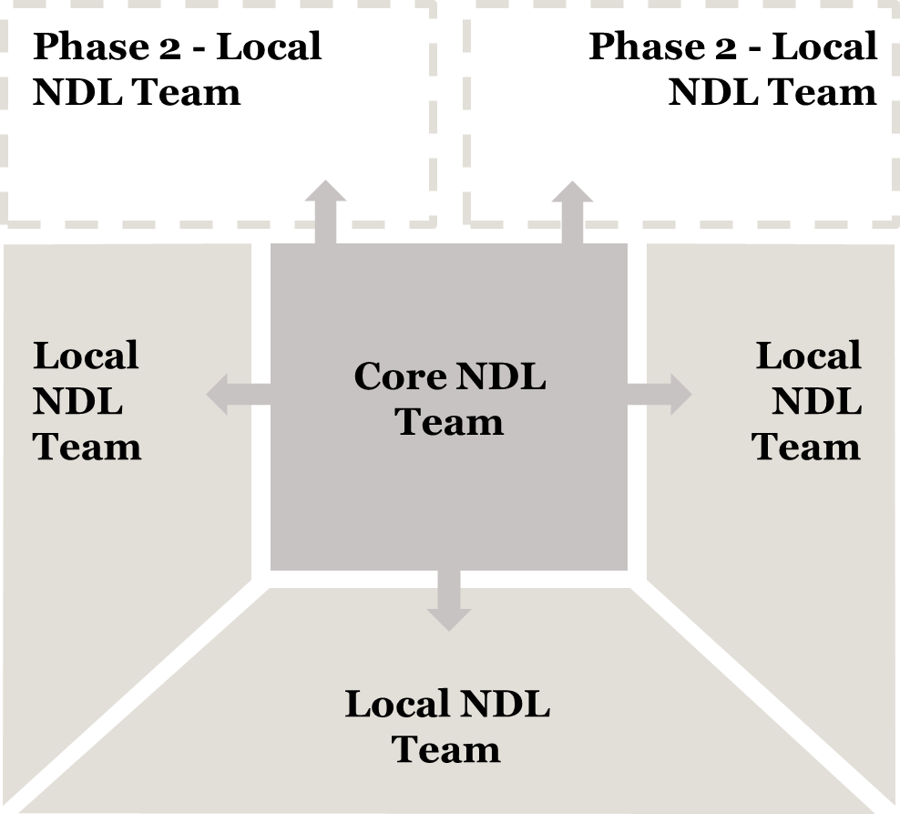



Networked Data Lab
In-depth analytical research
Analysis of trends
Data Stewardship
https://www.health.org.uk/the-networked-data-lab
Notes:
The aim is to use linked datasets to provide insights which could be used by local and national leaders and policymaers to improve health and health care quality in the UK.
This is really different from our current way of working.
Currently we identify a single project and bring data into the SDE for that specific project. Under this model, we aren’t going to bring any data in house, rather we are going to leave the data within their local areas and conduct distributed analysis with the help of local analysts there. This has two benefits: 1) the IG is much easier because we aren’t transferring data and 2) we’ll be hopefully increasing the analytical capability within an area by working closely with their analysts.
The second reason is that it gives us access to linked data sets which are distributed across the UK which when analyses are pulled together should be nationally representative or at the very least, should give an indication of regional variations in services.

Slide 13
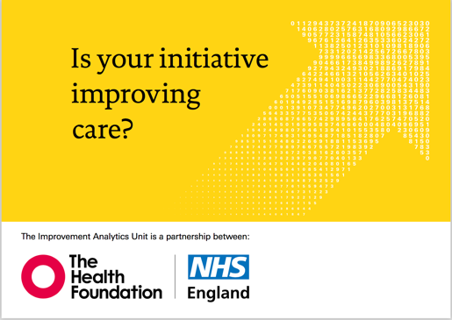
The Improvement Analytics Unit
We are working in partnership with NHS England to establish a resource that can:
Evaluate whether local change initiatives, implemented as part of national programmes, are improving care
Feed back to local and national level quickly, to help improve care
Use state-of-the-art evaluation methods from causal inference, as applied to existing data sets
https://github.com/THF-evaluative-analytics
https://www.health.org.uk/iau

Slide 14
An example of the IAU’s work

Slide 15
Advancing Applied Analytics
Advancing Applied Analytics funding
Support for analytical networks
Analytical Capability Index

Slide 16
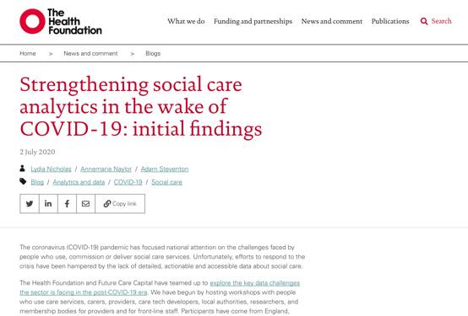
Strengthening Social Care Analytics
Community of practice (coming soon)

Slide 17
https://www.health.org.uk/what-we-do/data-analytics

